Slide 1
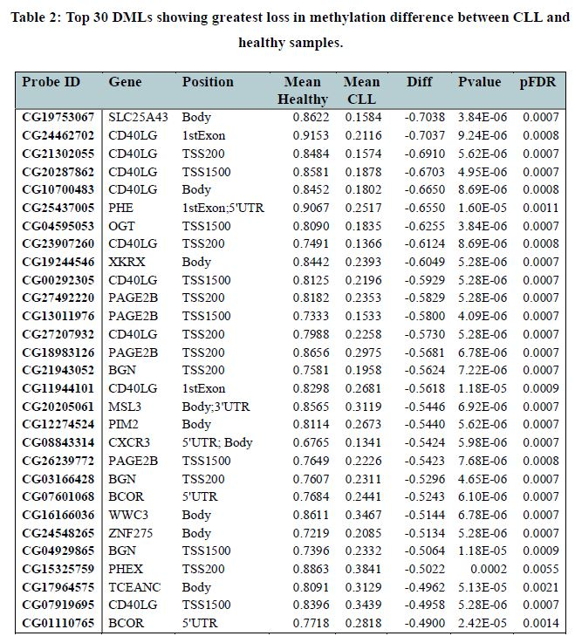
Findings
As part of my university dissertation in Bioinformatics, I carried out a differential methylation and gene expression analysis comparing Chronic Lymphocytic Leukaemia (CLL) patients with healthy controls.
The volcano plot highlights differentially methylated CpG sites between the two groups, while the heatmap visualises DMLs (Differentially Methylated Loci) linked to key genomic regions, showing clear separation between healthy and CLL samples.
A box plot illustrates differential gene expression for selected genes, and the Kaplan–Meier survival curve demonstrates the clinical relevance of one such gene by stratifying patients based on expression levels. Together, these visualisations provide insight into the epigenetic landscape of CLL.
© Teeshyna Jhummun 2025 –
Not for Reuse
Teeshyna Jhummun
BSc Applied Biomedical Science Graduate

Slide 2
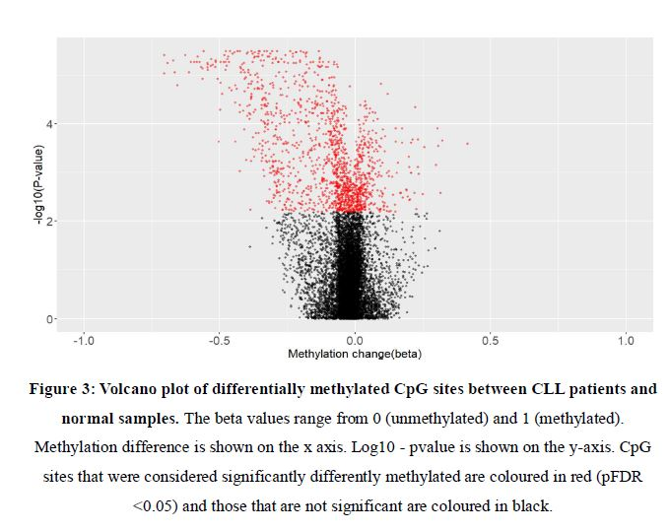
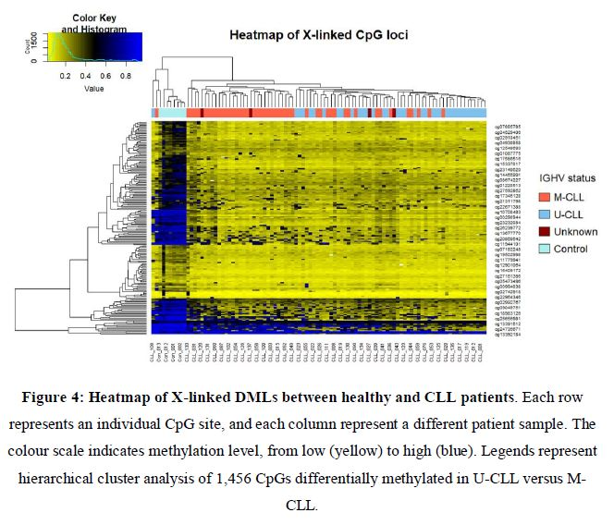
Teeshyna Jhummun
BSc Applied Biomedical Science Graduate
© Teeshyna Jhummun 2025 –
Not for Reuse
© Teeshyna Jhummun 2025 –
Not for Reuse
\\\\\

Slide 3
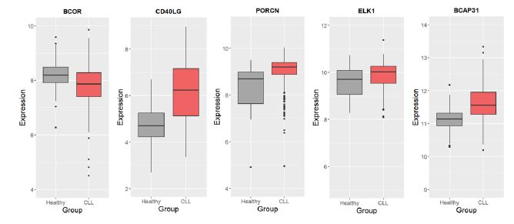
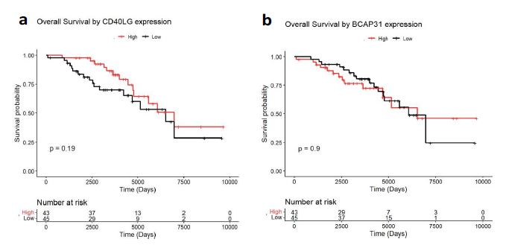
Teeshyna Jhummun
BSc Applied Biomedical Science Graduate
© Teeshyna Jhummun 2025 –
Not for Reuse
Box-plot : showing expression of key genes against healthy and CLL patients
© Teeshyna Jhummun 2025 –
Not for Reuse
Kaplan-Meier – Survival Analysis

